Slide 1

REACH
CONNECT TO THE WORLD WITH OUR WEBSITE

Slide 2
CONTENT
Group Information
Project Definition
Proposed System
Objectives of Proposed System
Development Platform
Use Case Diagram
Class Diagram
Activity Diagram
Data Dictionary

Slide 3
GROUP INFORMATION
GROUP NO : 3
GROUP MEMBERS:
Rohit Patel – B27
Dipal Shah – B42
Vrushika Shah – B50
Khushi Sharma – B54
Drashti Varaiya – B80
GUIDE:
DR. KRUPA MEHTA

Slide 4
PROJECT DEFINITION
REACH will be a social media website where everyone can connect with each other.
Long lost friends , your relatives , new people.
It is a free photo sharing website which can be shared publicly.
Even you can share the files on the platform.

Slide 5


PROPOSED SYSTEM
Categorized into TWO parts
ADMIN
USERS

Slide 6

PROPOSED SYSTEM
ADMIN
LOGIN
MANAGE USER DETAILS
MANAGE PASSWORDS
MANAGE LIKES,COMMENTS,POSTS
LOGOUT

Slide 7

PROPOSED SYSTEM
USER
LOGIN
SEND REQUEST
REGISTRATION
SAVE POST
MANAGE PROFILE
FOLLOW AND UNFOLLOW
SEARCH CONTENT
LOGOUT
SEND MESSAGE
LIKE AND COMMENT

Slide 8
DEVELOPMENT PLATFORM
HARDWARE :
SOFTWARE :
Processor | Intel CORE i5 8TH Generation
RAM | 8 GB
Hard disk | 1 TB
Operating System | Windows 11
Web Designing | HTML, CSS, JavaScript, Django
Front End | HTML,CSS
Back End | Django,SQLLite
Server | Local Host
Diagram Tool | Visual paradigm(16.2)
Presentation Tool | PowerPoint 2017

Slide 9
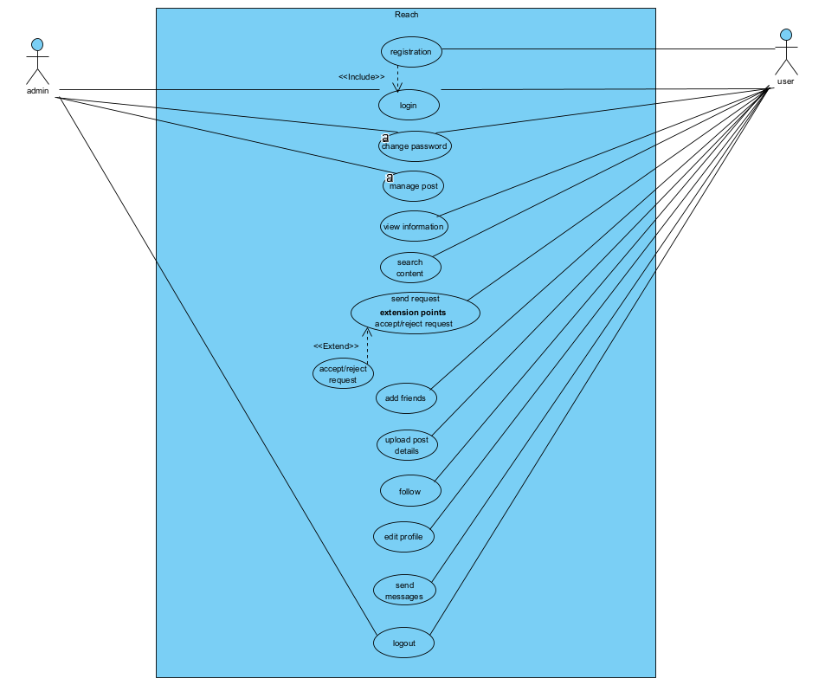
USE CASE DIAGRAM

Slide 10
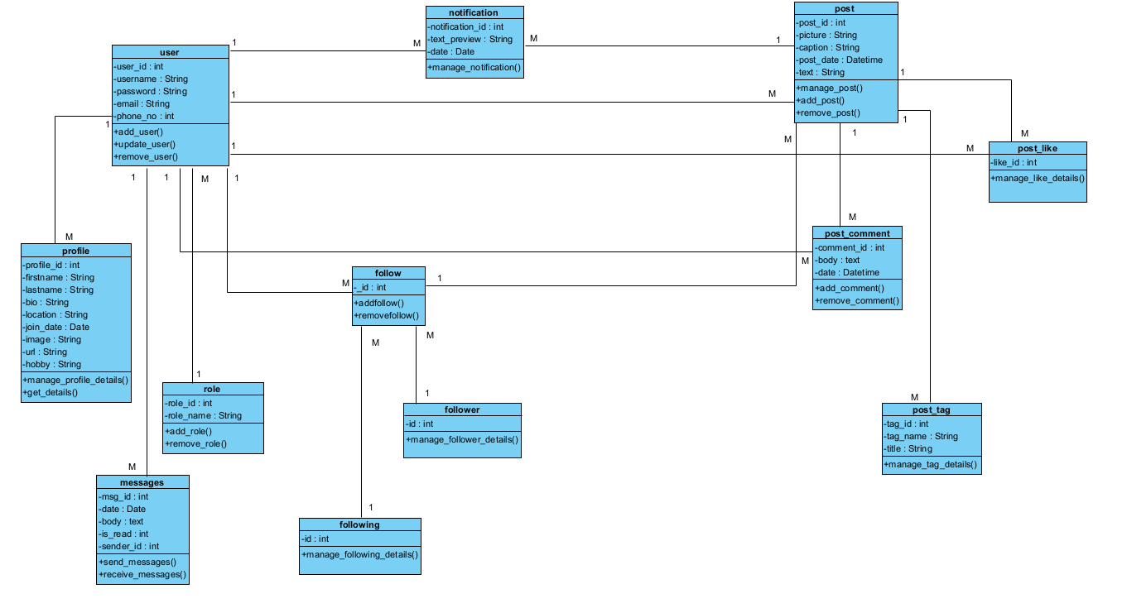
CLASS DIAGRAM

Slide 11
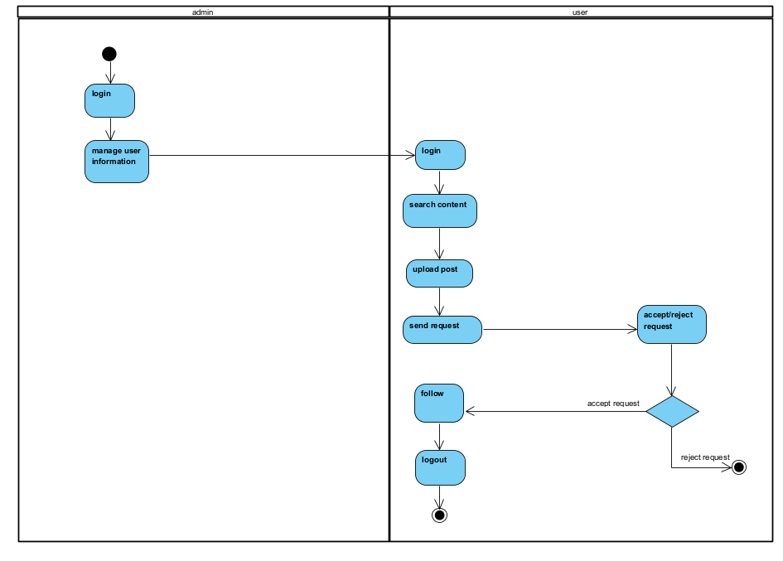
ACTIVITY DIAGRAM

Slide 12
DATA DICTIONARY
ROLE
Field name | Datatype | Constraints | Description
Role_id | INT | Primary key | Id of role
Role_name | VARCHAR(60) | Not null | Name of role

Slide 13
DATA DICTIONARY
USER
Field name | Datatype | Constraints | Description
User_id | INT | Primary key | Id of user
Username | VARCHAR(60) | Not null | Name of user
Password | VARCHAR(45) | Not null | Password of user
Email | VARCHAR(60) | Not null | Email of user
Phoneno | INT | Not null | Phoneno of user
Role_id | INT | Foreign key | Id of role

Slide 14
DATA DICTIONARY
PROFILE
Field name | Datatype | Constraints | Description
Profile_id | INT | Primary key | Id of profile
Firstname | VARCHAR(45) | Not null | Name of user
Lastname | VARCHAR(45) | Not null | Last name of user
Bio | VARCHAR(45) | Not null | Bio of user
City | VARCHAR(45) | Not null | City of user
Join_date | DATETIME | Not null | Date of user
Image | VARCHAR(255) | Not null | Image of user
Url | VARCHAR(255) | Not null | url of profile
Hobby | VARCHAR(45) | Not null | Hobby of user
User_id | INT | Foreign key | Id of user

Slide 15
DATA DICTIONARY
NOTIFICATION
Field name | Datatype | Constraints | Description
Notification_id | INT | Primary key | ID of Notifination
Text_preview | VARCHAR(100) | Not null | Show Text details
Date | DATETIME | Not null | Date of notification
User_id | INT | Foreign key | Id of user
Post_id | INT | Foreign key | Id of post

Slide 16
DATA DICTIONARY
POST
Field name | Datatype | Constraints | Description
Post_id | INT | Primary key | id of post
Picture | VARCHAR(45) | Not null | Picture of post
Caption | VARCHAR(45) | Not null | Caption pf post
Post_date | DATETIME | Not null | Date of post
Text | VARCHAR(45) | Not null | Text of post
User_id | INT | Foreign key | id of user
Post_follow_id | INT | Foreign key | Id of post_follow

Slide 17
DATA DICTIONARY
POST FOLLOW
Field name | Datatype | Constraints | Description
Id | INT | Primary key | ID of post follow
Follower_id | INT | Foreign key | ID of follower
Following_id | INT | Foreign key | ID of following
User_id | INT | Foreign key | ID of user
Post_id | INT | Foreign key | ID of post

Slide 18
DATA DICTIONARY
FOLLOWING
Field name | Datatype | Constraints | Description
Following_id | INT | Primary Key | ID of following

Slide 19
DATA DICTIONARY
FOLLOWER
Field name | Datatype | Constraints | Description
Follower_id | INT | Primary Key | ID of follower

Slide 20
DATA DICTIONARY
POST LIKE
Field name | Datatype | Constraints | Description
Like_id | INT | Primary key | Id of like
User_id | INT | Foreign key | Id of user
Post_id | INT | Foreign key | Id of user

Slide 21
DATA DICTIONARY
POST COMMENT
Field name | Datatype | Constraints | Description
Comment_id | INT | Primary key | Id of post
Body | Text | Not null | Body of comment
Date | DATETIME | Not null | Date of comment
Post_id | INT | Foreign key | Id of post
User_id | INT | Foreign key | Id of user

Slide 22
DATA DICTIONARY
POST TAG
Field name | Datatype | Constraints | Description
Tag_id | INT | Primary key | Id of tag
Tag_name | VARCHAR(45) | Not null | Id of name
Post_id | INT | Foreign key | Id of post
user_id | INT | Foreign key | Id of post tag

Slide 23
DATA DICTIONARY
MESSAGE
Field name | Datatype | Constraints | Description
Msg_id | INT | Primary key | Id of message
Date | DATETIME | Not noll | Date of message
Body | Text | Not null | Body of message
Is_read | INT | Not null | Show message
receiver_id | INT | Foreign key | Id of receiver
User_id | INT | Foreign key | Id of user

